Slide 1
TRANSITIONING FROM PRESCHOOL SPECIAL EDUCATION TO KINDERGARTEN
Nicole Parete, Coordinator of Special Education
David Albert, Coordinator of Special Education
Danielle Krebs, School Psychologist & CPSE Chair
Amanda Manner, Speech/Language Pathologist
Megan Behrens, Occupational Therapist

Slide 2
LAST CPSE MEETING
Annual review to discuss progress
Determine if Extended School Year services (ESY) are appropriate
Determine whether your child will be:
Declassified OR
Referred to the Committee on Special Education (CSE)

Slide 3
What Does Declassification/Ineligibility Mean?
At the CPSE Annual Review, your child may demonstrate achievement of their IEP goals or score within the average range on various assessments. They no longer require special education services and will not be referred to the CSE for school age services.
Your child has made progress, grown exponentially, and learned many concepts and behaviors necessary for success in Kindergarten.
That is a good thing!
Most children who are declassified under CPSE do very well in Kindergarten.

Slide 4
Student Moving to CSE
Your preschooler is currently receiving special education services as a “preschooler with a disability”
New York State Education Department has established 13 classifications that lead to CSE eligibility
There are specific criteria for meeting each classification
Autism
Deafness
Deaf-Blindness
Emotional Disturbance
Hearing Impairment
Intellectual Disability
Orthopedic Impairment
Other Health Impairment
Learning Disability
Multiple Disabilities
Speech-Language Impairment
Traumatic Brain Injury
Vision Impairment

Slide 5
Why A Classification?
Regulations require a specific disability classification for children ages 5-21 who receive special education services
Classifications are descriptors of a child’s area of need; not a description of who a child is
Classifications do not determine what services are delivered; the team developing the IEP (Individualized Education Program) determines services

Slide 6
Committee on Special Education (CSE) Members
-Parent(s)/Guardian(s) of the student
-Chairperson/District Representative
-General Education Teacher
-Special Education Teacher
-School Psychologist
-Related Service Provider(s)
-Individual to interpret evaluations (may be one of the other committee members)
-Parent Member (if requested)
-School district’s physician (if requested)
-Others who have knowledge regarding the student (parent or district invite)
-Student (if appropriate)

Slide 7
Eligibility for CSE
Determined by a multidisciplinary team
Dependent on multiple sources of information including interview, observation, evaluations, screenings
Evaluations do not always need to be completed for children who are moving from CPSE to CSE as a review of current information is appropriate

Slide 8
Continuum of Services for Special Education
Related Services Only (e.g., Speech/Language Therapy)
Consultant Teacher Services
Resource Room
Integrated Co-Teaching (ICT)
Special Class
Other placements outside of the district

Slide 9
As a parent, you can expect:
To be fully informed
To be notified about meetings at least 5 days in advance
To participate in decision making
To have all information explained
To have confidentiality maintained

Slide 10
What happens if my child is declassified or ineligible for CSE and begins to struggle in school?
The district has Response to Intervention (RTI) teams that meet in every elementary building

Slide 11
District Supports

Slide 12
Speech & Language Services
At Wallkill Central School District, Speech & Language services can be provided in a variety of ways:
Speech and Language as a Related Service on an IEP
Speech and Language as a Related Service on a 504 Plan
Speech and Language as a general education service through Speech Improvement

Slide 13
Speech & Language Services as a Related Service on an IEP
To receive speech and language services on an IEP the student must qualify under NYS guidelines.
Student's speech and language deficits impact their academic success.
Decisions regarding speech and language supports as a related service on an IEP are determined by the Committee on Special Education.
If students do not require supports from a Special Education teacher, but are deemed eligible for speech and language services, they may qualify for an IEP with related services only.

Slide 14
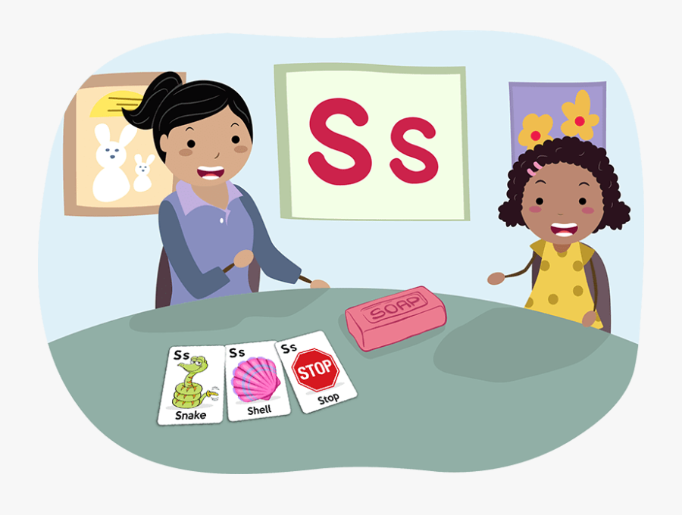
Speech & Language Support through Speech Improvement Services
Speech Improvement Services are a General Education Support
Students may qualify for speech improvement services following a referral by the classroom teacher and a short, informal screening process conducted by the building's Speech-Language Pathologist.
**These services are provided in all buildings throughout our district**

Slide 15
Occupational Therapy (OT)
What skills does OT in school address?
School based OT services address a student's needs in the areas of Visual Motor, Fine Motor, Visual Perceptual, and Sensory Processing skills that are having an impact on the child’s ability to participate in academics.
How does a child qualify for school-based OT services?
School based OT services are provided either through an IEP (special education) or a 504. All OT evaluations are completed at the request of the CSE or 504 committee. A student must have an IEP or 504 to receive OT services in the school.
A combination of standardized assessment tools, observation of functional skills, and teacher/parent input are used to determine an OT recommendation as discussed by the CSE or 504 committee.
In order to qualify for school-based OT, the concerns much be impacting the child’s ability to complete academic tasks. They are in school to learn, so in order to justify pulling them from the classroom where that learning occurs, the need must rise to the level of significance of impeding academic function. This differs from medical based OT services which can be provided outside of the school setting for a variety of reasons.

Slide 16
OT
What levels of OT service are offered in school?
The level of OT service ranges from a consult with the teacher, push in sessions to the classroom, and pull out sessions. OT services can be provided in a small group or individually depending on the needs of the student and the goals to be addressed.
Our therapists also provide strategies to the RTI team as well as any teacher that requests them to assist all children.
What skills will be expected of my kindergartener?
Children entering kindergarten have a wide range of skills and school experiences. So much of the regular kindergarten curriculum supports fine motor and sensory development.

Slide 17
School based Physical Therapy
School-based physical therapists (PT) are part of a team of related service providers who support a student’s ability to access his/her educational environment. As specialists in movement, they assist a student’s physical participation in a variety of settings throughout the school day. The primary role of the school PT is to help students benefit from their educational program within the educational environment.
School-based physical therapy is different from medical based physical therapy and determining the need for each of these services is different. Medical based physical therapy is typically provided in an outpatient therapy clinic or hospital. These services address quality of movement as well as function. Its primary objective is to maximize the child’s skill level and quality of movement. Medically-based services are typically focused on a student’s physical impairments and clinical deficits.

Slide 18
Physical therapy is provided at schools only when it is related to educational needs. Intervention and goals in the school setting address the child’s functional needs in accessing all areas of the school curriculum. Physical therapy interventions are designed to enable the student to travel throughout the school environment; participate in classroom activities; maintain and change positions in the classroom; as well as manage stairs, restrooms, and the cafeteria. School-based therapy is not intended to meet all of the therapeutic needs of a student; rather it is intended to ensure that a child can have physical access to his or her education.
PT in a school setting can vary based on a student’s individual needs, and can include:
Modifying the environment to maximize participation (i.e., adaptive seating)
Altering expectations to maximize success and independence
Educating staff to enhance physical participation

Slide 19
WHO IS ELIGIBLE FOR SCHOOL-BASED PHYSICAL THERAPY?
First and foremost, the proposed service must be educationally relevant. Secondly, the child’s needs must be able to be addressed only by the skilled service of a physical therapist. Some common physical concerns can be addressed by the classroom staff, with the support and consultations of a physical therapist.

Slide 20
Physical therapy services may be direct or indirect.
For direct intervention, the therapist works with the student on a consistent basis either individually or in a group setting. This can be provided in the therapy room, classroom, physical education gym, playground, or any other location where the student needs to practice motor skills.
For indirect intervention, the therapist will consult with classroom staff and other interventionists to make recommendations and suggest strategies to enhance to student’s independence and participation in school.

Slide 21
COUNSELING
Group and individual counseling is available in each elementary building to address social/emotional functioning in school
A full-time social worker is assigned to each elementary school
Social workers also push into classrooms to address issues such as bullying, friendship skills and emotions.

Slide 22
Additional Supports
The district also provides specialized instruction for:
students who are blind/visually impaired;
students who are deaf/hearing impaired;
any other services recommended by the CSE based on the individual needs of the student.

Slide 23
Section 504 Plans
A 504 plan is a blueprint for how a school will provide support and remove barriers for a student with a disability
A 504 plan provides services and changes to the learning environment to enable students to learn alongside their peers
A 504 plan covers a wide range of different struggles in school. The disability must interfere with a child’s ability to learn in a general education classroom. The disability must substantially limit one of more basic life activities. This can include learning, reading, communicating and thinking

Slide 24
Section 504 Plans Continued
504 plans often include accommodations. These can include changes to the environment, changes to instruction, changes to how curriculum is presented.
Accommodations do not change what a child learns, just how they learn it.
Some children may get services to help build skills (For example, OT and PT).
Some might get supports for social and emotional challenges.
504 plans can provide modifications. Modifications change what a student is taught or expected to learn. For instance, a student might get fewer homework assignments.
A 504 Plan is requested through your building principal

Slide 25
Tips for Parents
You are an excellent source of information about your child. Your input to your child’s program is valuable and important.
A team approach, in which you and the school are working together, is the BEST approach.
Keep in contact with your child’s teacher on a regular basis. Informal conversations or notes are an excellent way to stay informed and establish a relationship with your child’s teacher.

Slide 26
QUESTIONS
Contact Nicole Parete
(845) 895-7104
nparete@wallkillcsd.k12.ny.us
Contact David Albert
(845) 895-7104
dalbert@wallkillcsd.k12.ny.us
Contact Danielle Krebs
(845) 895-7114
dkrebs@wallkillcsd.k12.ny.us

